Slide 1
ONLINE
Optimize Checkout Flow
Cai Bang Team:
1. Pham Thi Quynh Lam
2. Nguyen Huu Thang
3. Nguyen Thanh Binh

Slide 2
Checkout Flow Optimization Analysis
PAY
01
Overview & Objective
02
Prepare & Explore Data
03
Visualize & Evaluate
04
Solution & Conclusion

Slide 3
Online platform checkout flow
Add products to cart
Enter billing & shipping details
Receive confirmation
Browse
Product
Login/
Guest
Make
payment

Slide 4
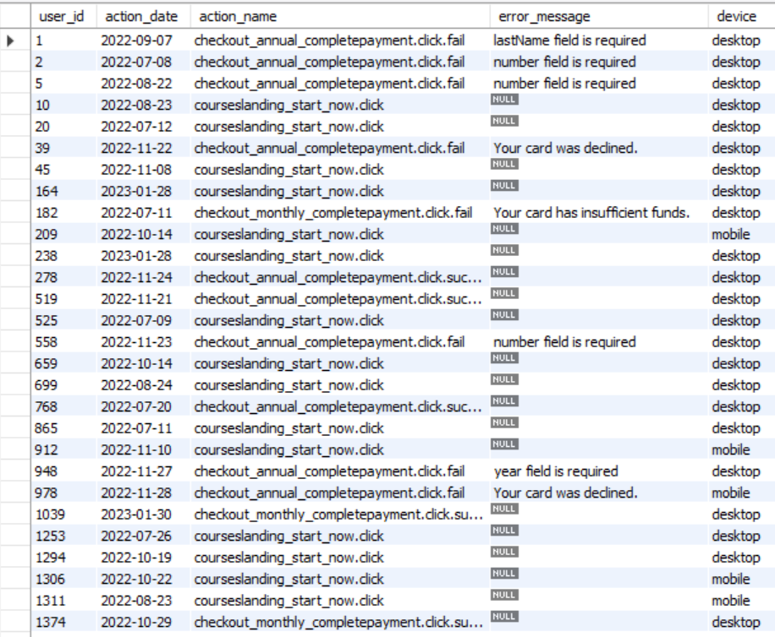
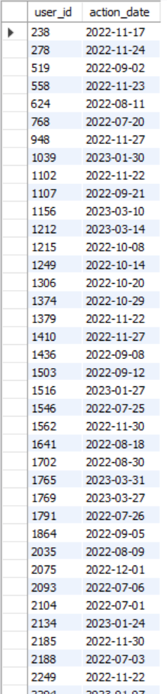
Database Descriptions
checkout_actions table
checkout_carts table

Slide 5
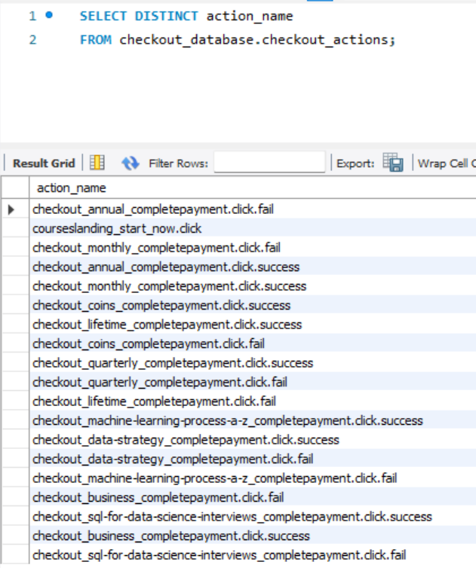
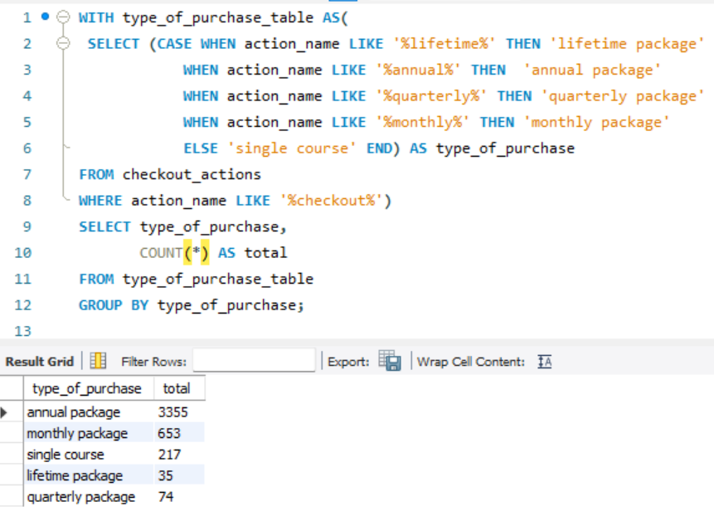
Explore Data
Lifetime package
Annual Package
Quarterly package
Monthly Package
Single Course

Slide 6
User Categories
Failed Checkout
Successful Checkout
Abandoned Carts
A user encounters problems while paying and cannot complete the transaction
A user completes a payment for a subscription without any issues
A user adds a subscription to their cart but leaves without finalizing the payment
SERVICES
PAY
FAILED

Slide 7
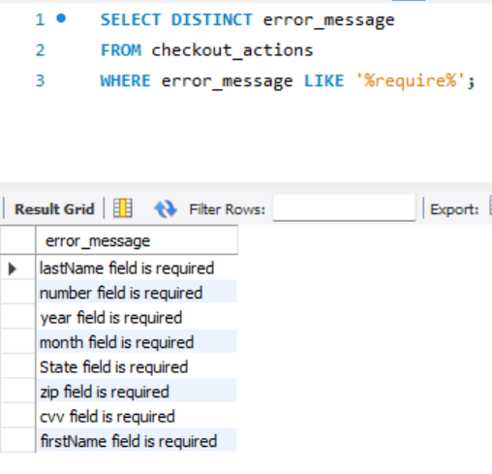
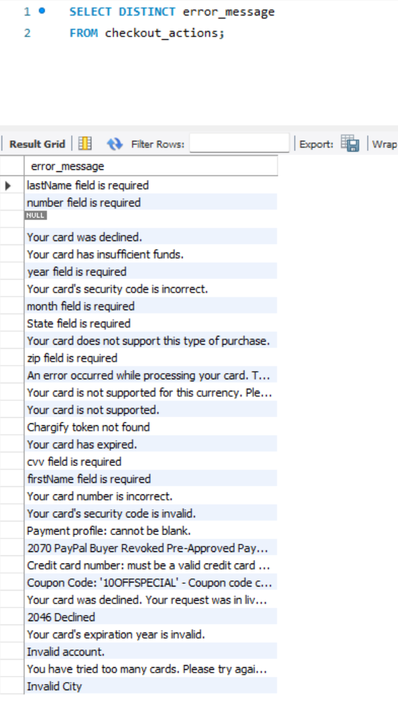
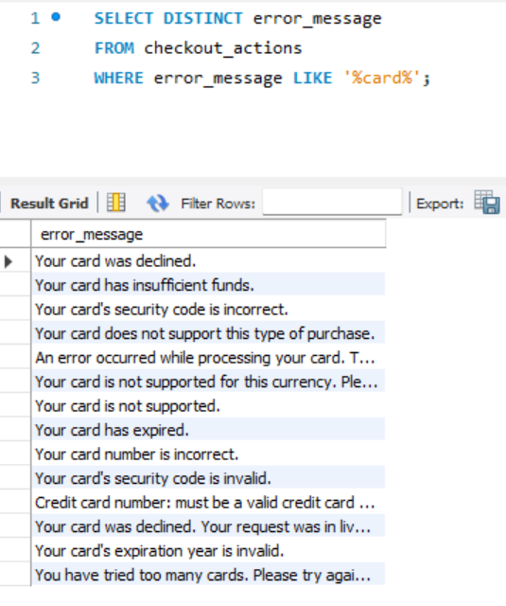
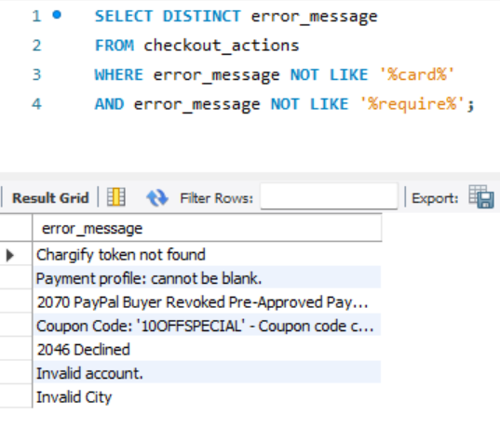
Explore Data
Required
Errors related to leaving information fields empty
Card
Errors related to payment method
Others
Other errors such as invalid information…

Slide 8
Difine the vital metrics
Element 1
Total checkout success
Total checkout attempts
Element 2
Element 3
Monthly checkout success rate
Total checkout fail
+
=
Monthly cart abandonment rate
Total created carts
-
Total checkout attempts
=
Total abandoned carts
Most common Checkout errors & Device correlations
Total errors on desktop
+
Total errors on mobile
=
Total errors

Slide 9
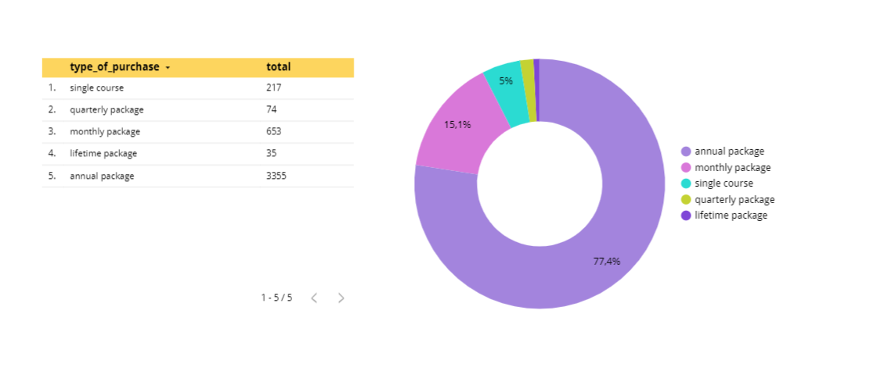
About Data
Items Has Been Sold

Slide 10
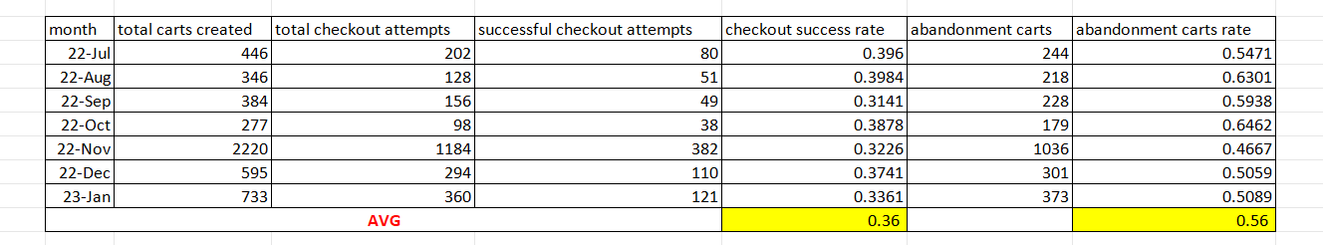
About Data
Retrieve Checkout Step Information

Slide 11
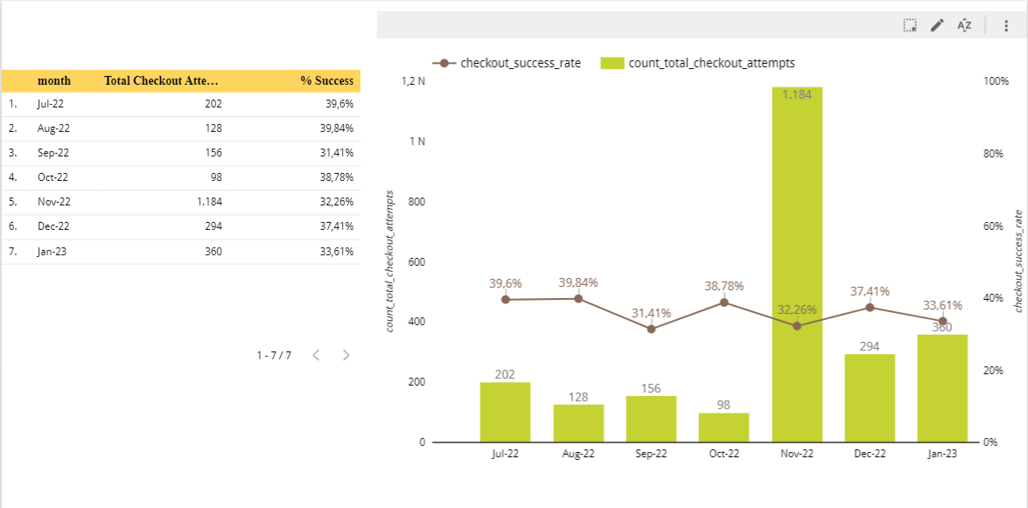
Visualize & Evaluate

Slide 12
Causes of the difference in success rates and total attempts
Complicated process
Free Time
Waiting for discounts near the end of the year
Because there is a lot of free time during July and August, the success rate is high
Sucess rates
&
total attempts
Sales
Limited method
The biggest sale of the year is in November, Black Friday
Apply wrong payment method that is not in list

Slide 13
The monthly number of checkout carts and the relevant abandonment rates.
Retrieve Checkout Step Information

Slide 14
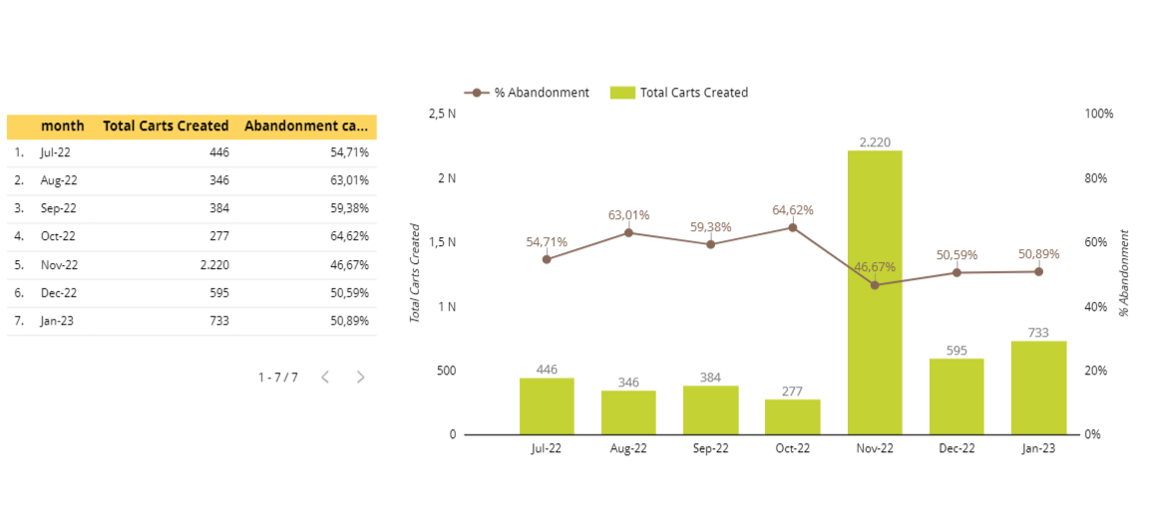
Visualize & Evaluate
Solution

Slide 15
Causes of the monthly number of checkout carts and the relevant abandonment rates
01
04
Login to pay
Waiting & Sales
Customers wait for big sales that cause rate differences
The system requires customers must to log in to receive payment
01
04
The cycle repeats every year
02
02
03
03
Extra cost
Payment process
Maybe the price is too high, making customers confused
Customers no longer want to pay because the payment procedure is too difficult.

Slide 16
Solution
QUICK ACCESS
NOTIFICATION
Use "Quick Sign-In" or "One-Click Sign-In“ feature or link to social network acc
15%
Send clients an email letting them know what's still in their basket so they won't forget.
5%
15%
ADVERTISING
20%
10%
DISCOUNTS
Increase advertising of products with high purchase numbers
Offer monthly discounts
TRUST
35%
Provide recommendations
Create trust with product reviews to increase success rate
Suggest relevant courses on the website and app

Slide 17
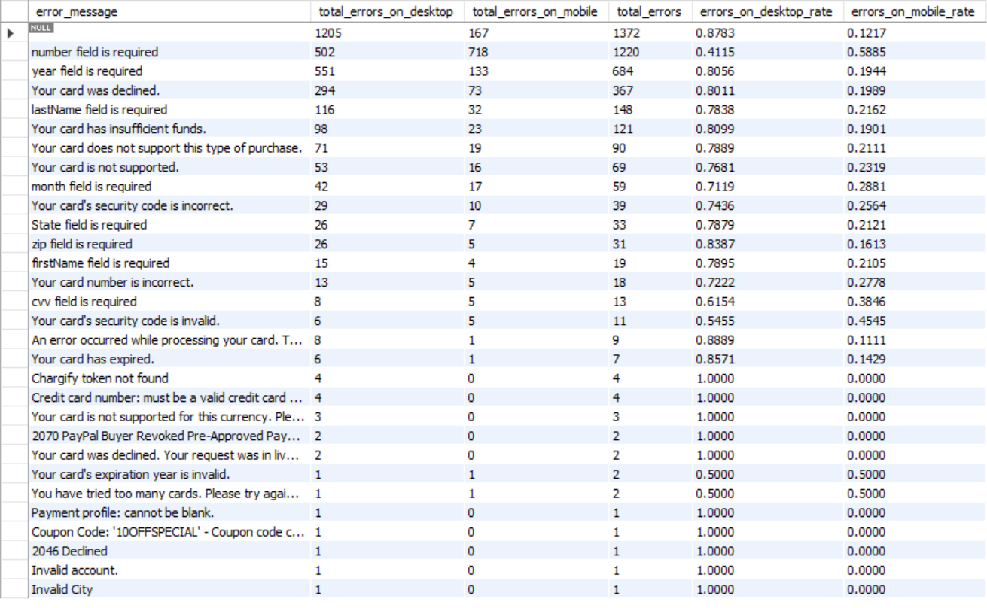
Retrieve Checkout Error Information

Slide 18
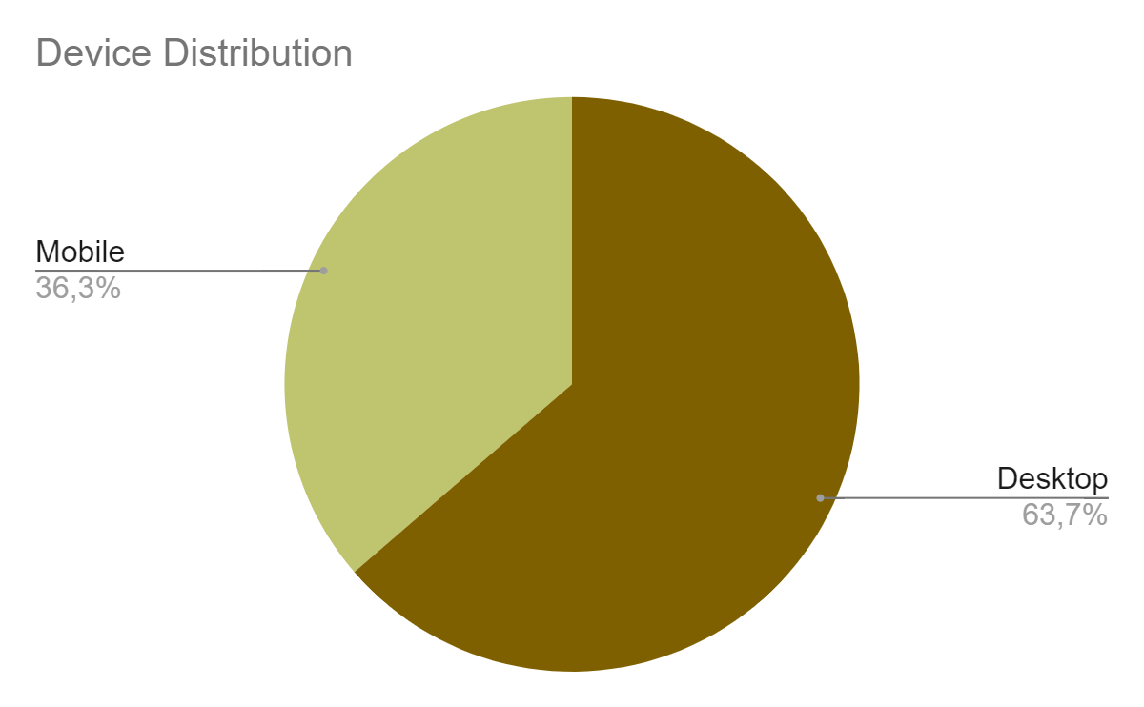
Device distribution
63,7%
Desktop
36,3%
Mobile

Slide 19
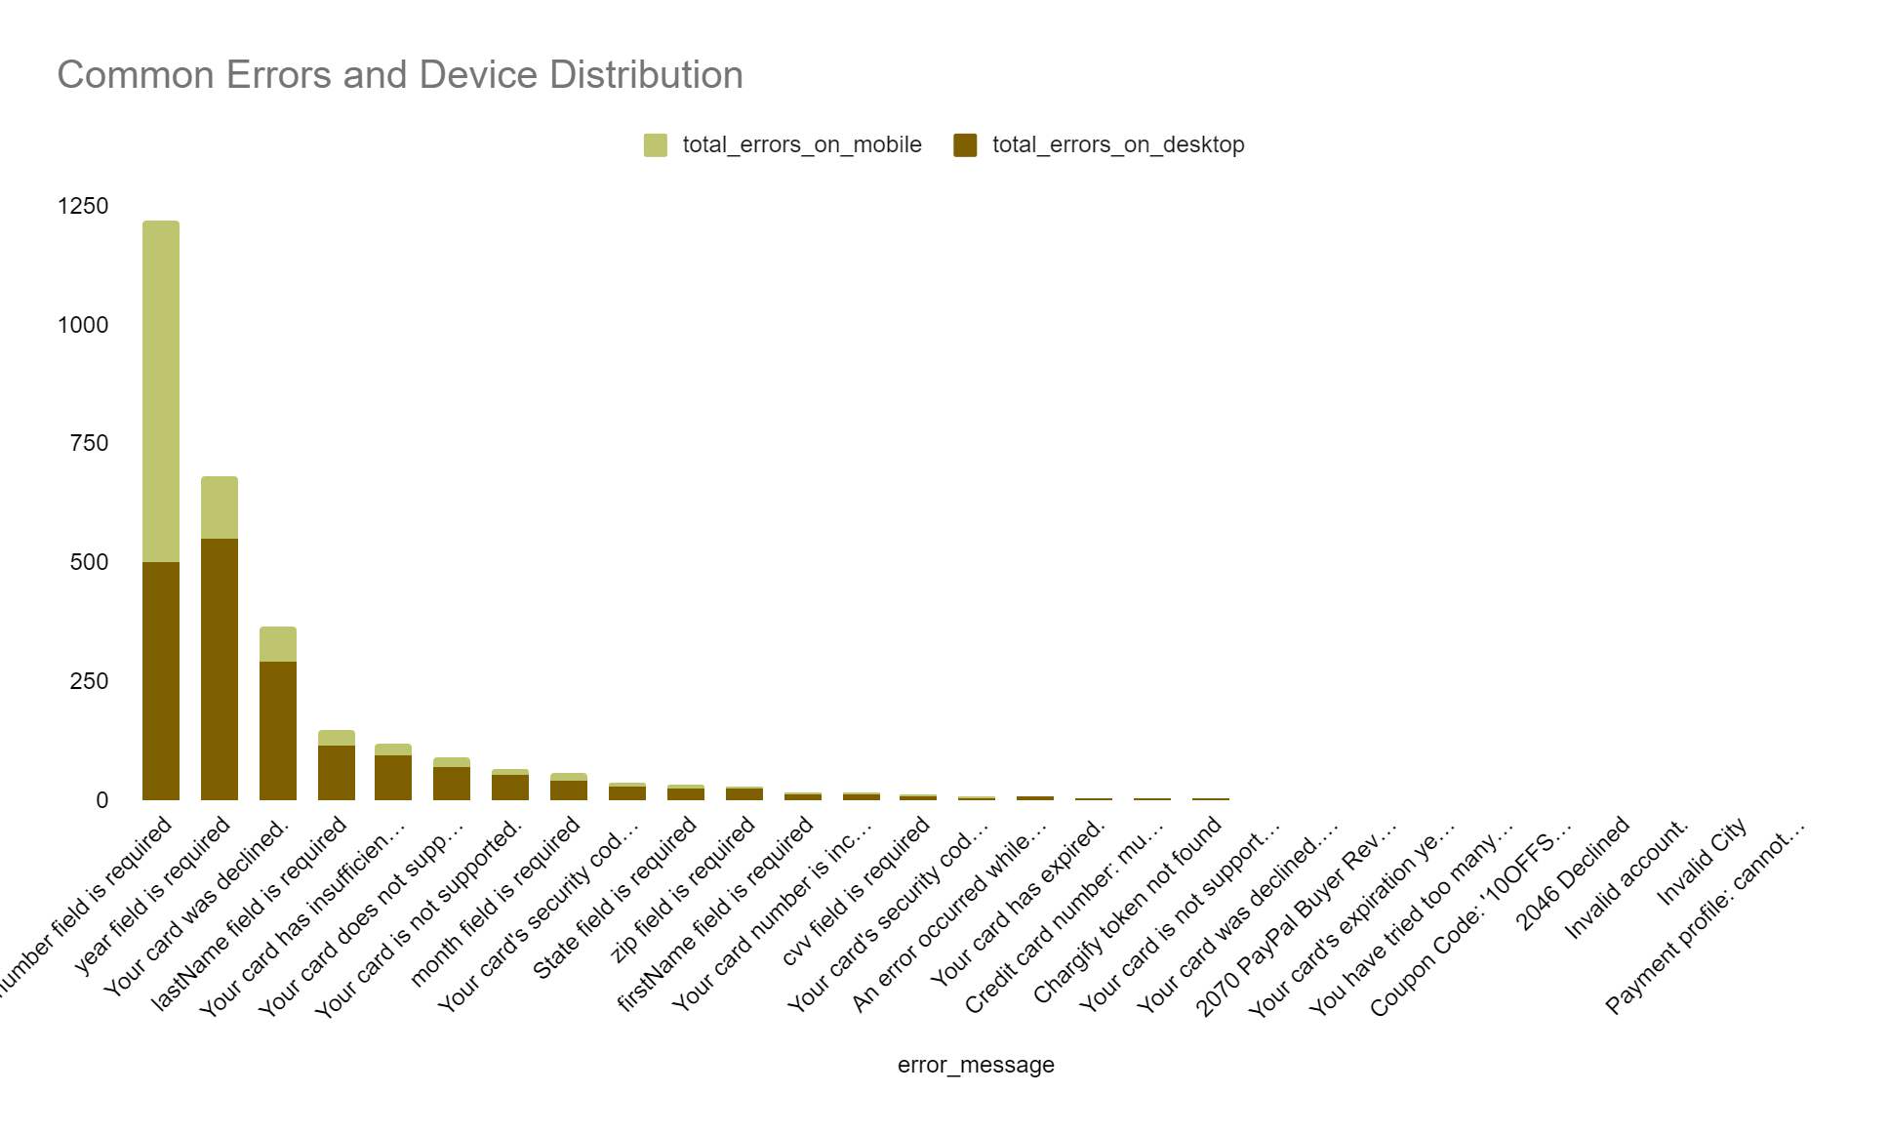
Common errors
Number
field
Year
field
Card
denied
Lastname
field

Slide 20
Cause of differnce in device distribution & common errors
A
B
C
Payment method
User interface/ experience
Too much unnecessary field
Few payment method/unclear payment constraints
Operations on the desktop easier than on the mobile
Customer skip fields that they feel unnecessary

Slide 21



Solution
UI/UX
Enhance mobile applications
User experience survey
Test and improve user experience
Add unique features for mobile
Required
Add the autofill feature with the existing information
Use Google Auto-fill complete address
The unnecessary fields
Remove unnecessary fields
Using visual cues to guide customer through checkout
Payment
Diversity of payment methods
Payment security

Slide 22
Conclusion
High cart abandonment rate
Waiting & Sales Extra Cost Login to pay Payment process
Marketing Advertising Make believe Use “Quick access” feature
High cart abandonment rate
2
Story
Low checkout success rate
Complicated process
Free time
System error
Limited payment method
1
Reduce the number of steps needed to complete payment
Enhance UI/UX on mobile Apply Technology & Security Diversity of payment methods
UI/UX
Unnecessary fields
Payment method
Desktop > Mobile Common errors related to required fields & payment method
3

